Slide 1

Compare single cell RNA transcriptomic profiles across different stages of spermatogenesis using Shiny app
Qiyang Liu
BIO5202

Slide 2
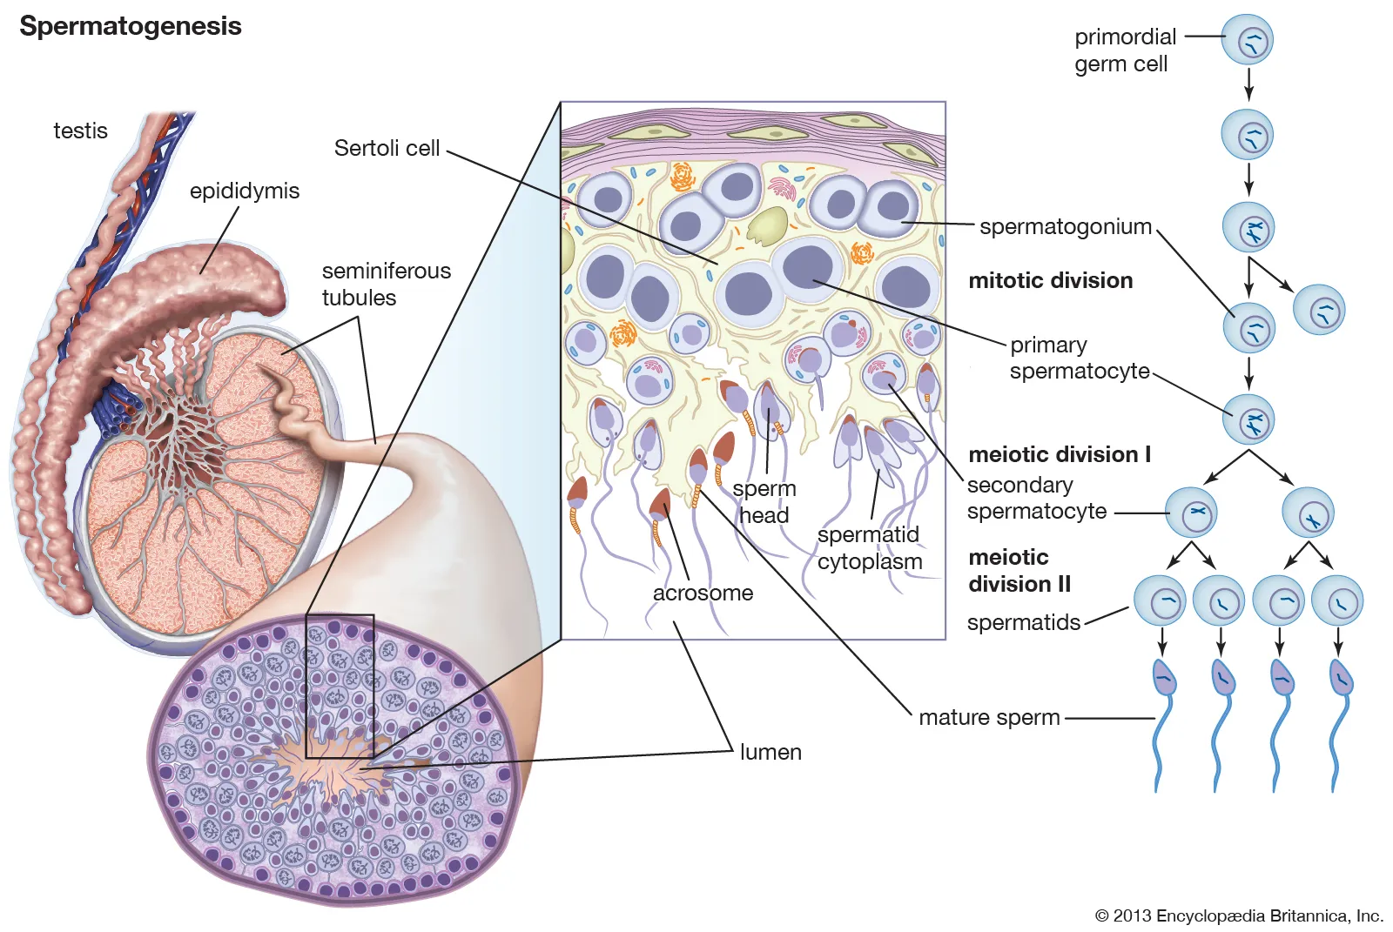
Background
Spermatogenesis
The process of sperm formation
Looking for gene regulators that are conserved across species
Male infertility, species protection, food animals, etc.

Slide 3
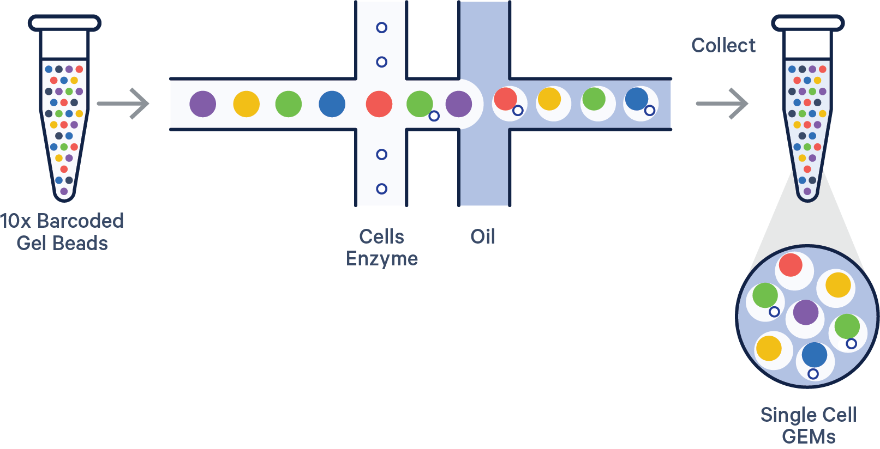

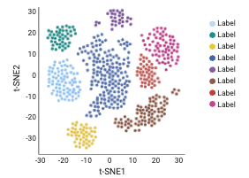
Research questions
How to identify and analyze different stages of spermatogenesis?
Single cell RNA sequencing (scRNA-seq)
E.g., 10X genomics
How to better display and interpret a scRNA-seq dataset?
Shiny App

Slide 4
Objective
Obtain and reconstruct testicular scRNA-seq data
Create an interactive Shiny App
Personalized display
Cell stage
Biomarkers (genes of interest)
Species
Plots
Etc.
Accessible and downloadable by public

Slide 5
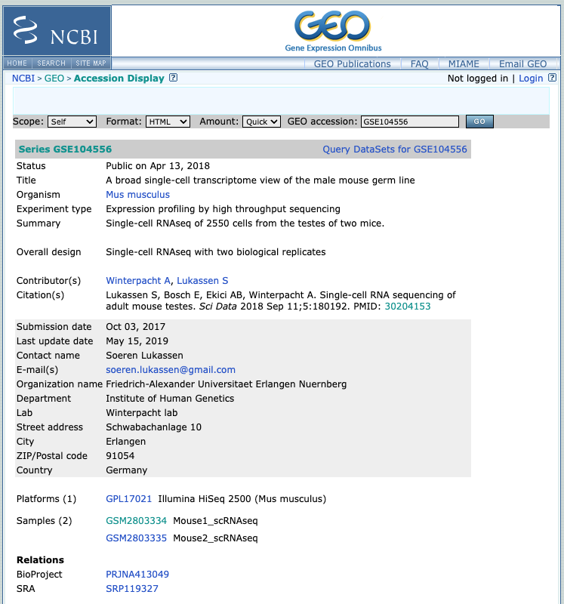
Obtain scRNA-seq Data
Mining Data
10X Genomics
NCBI-GEO

Slide 6
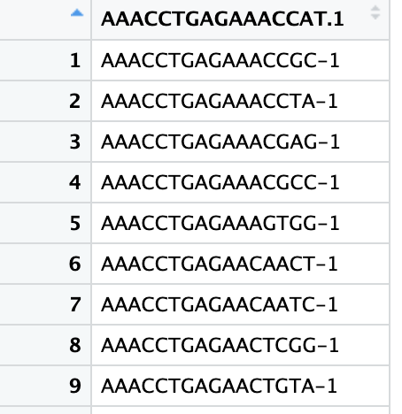
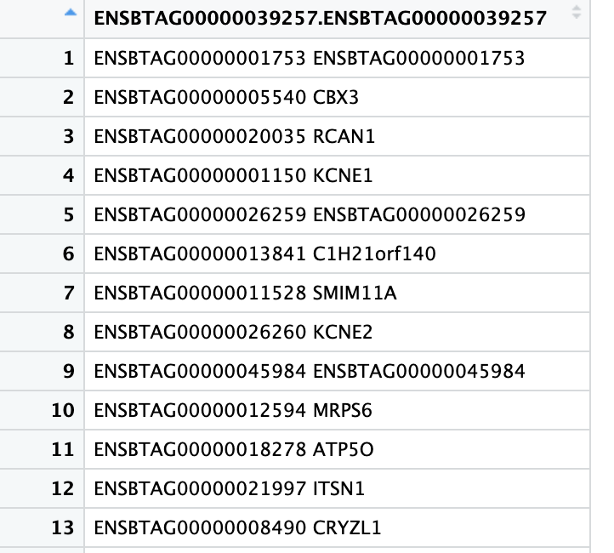
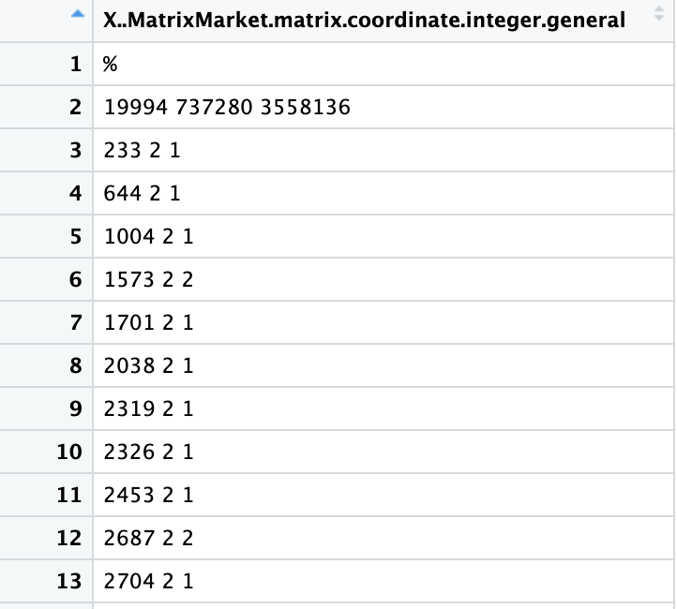
R package of Seurat
scRNA-seq dataset that is composed of three files
Barcode
Feature
Matrix

Slide 7
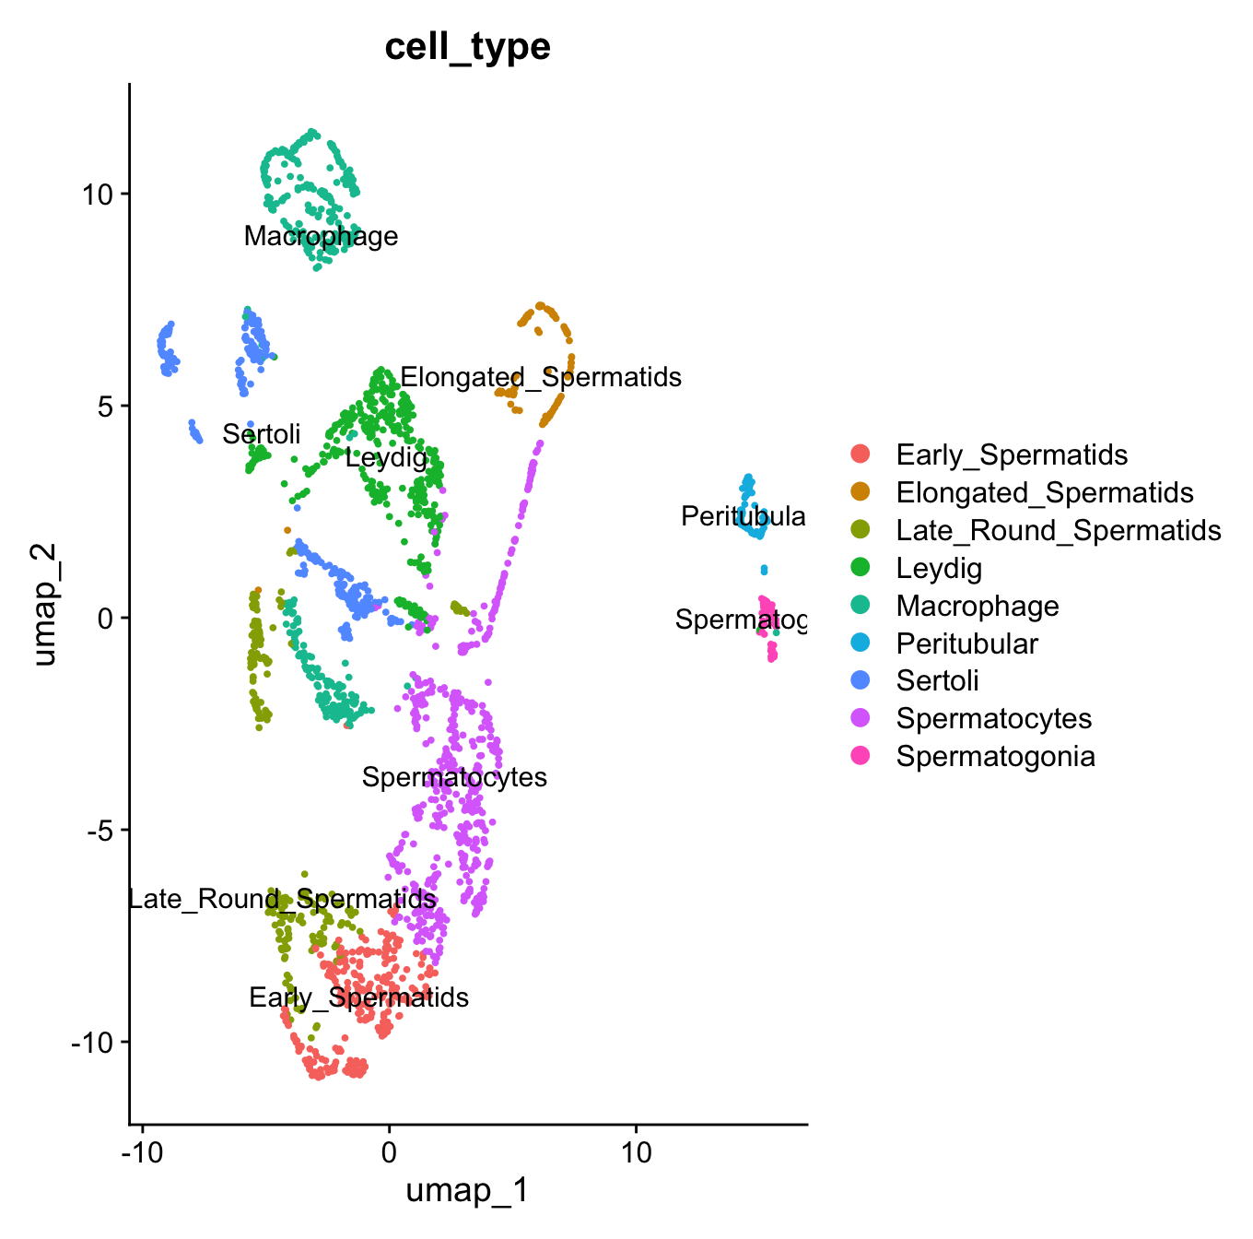
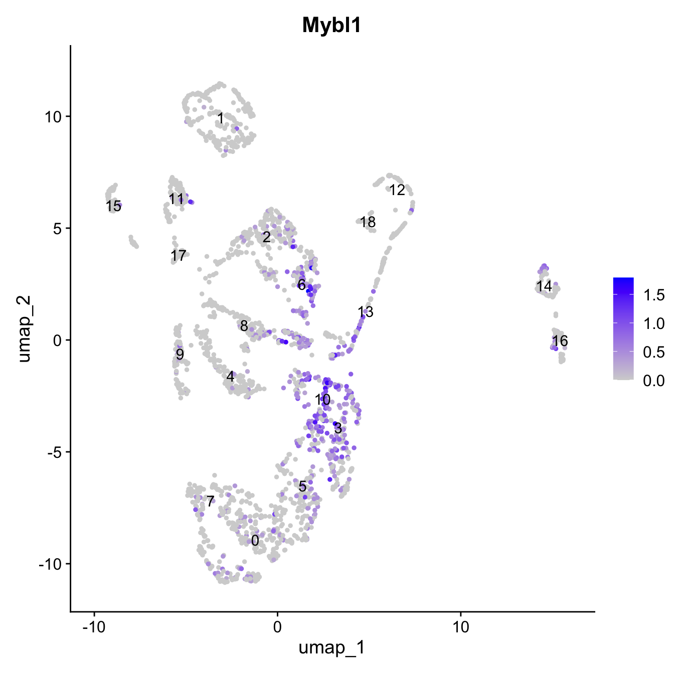
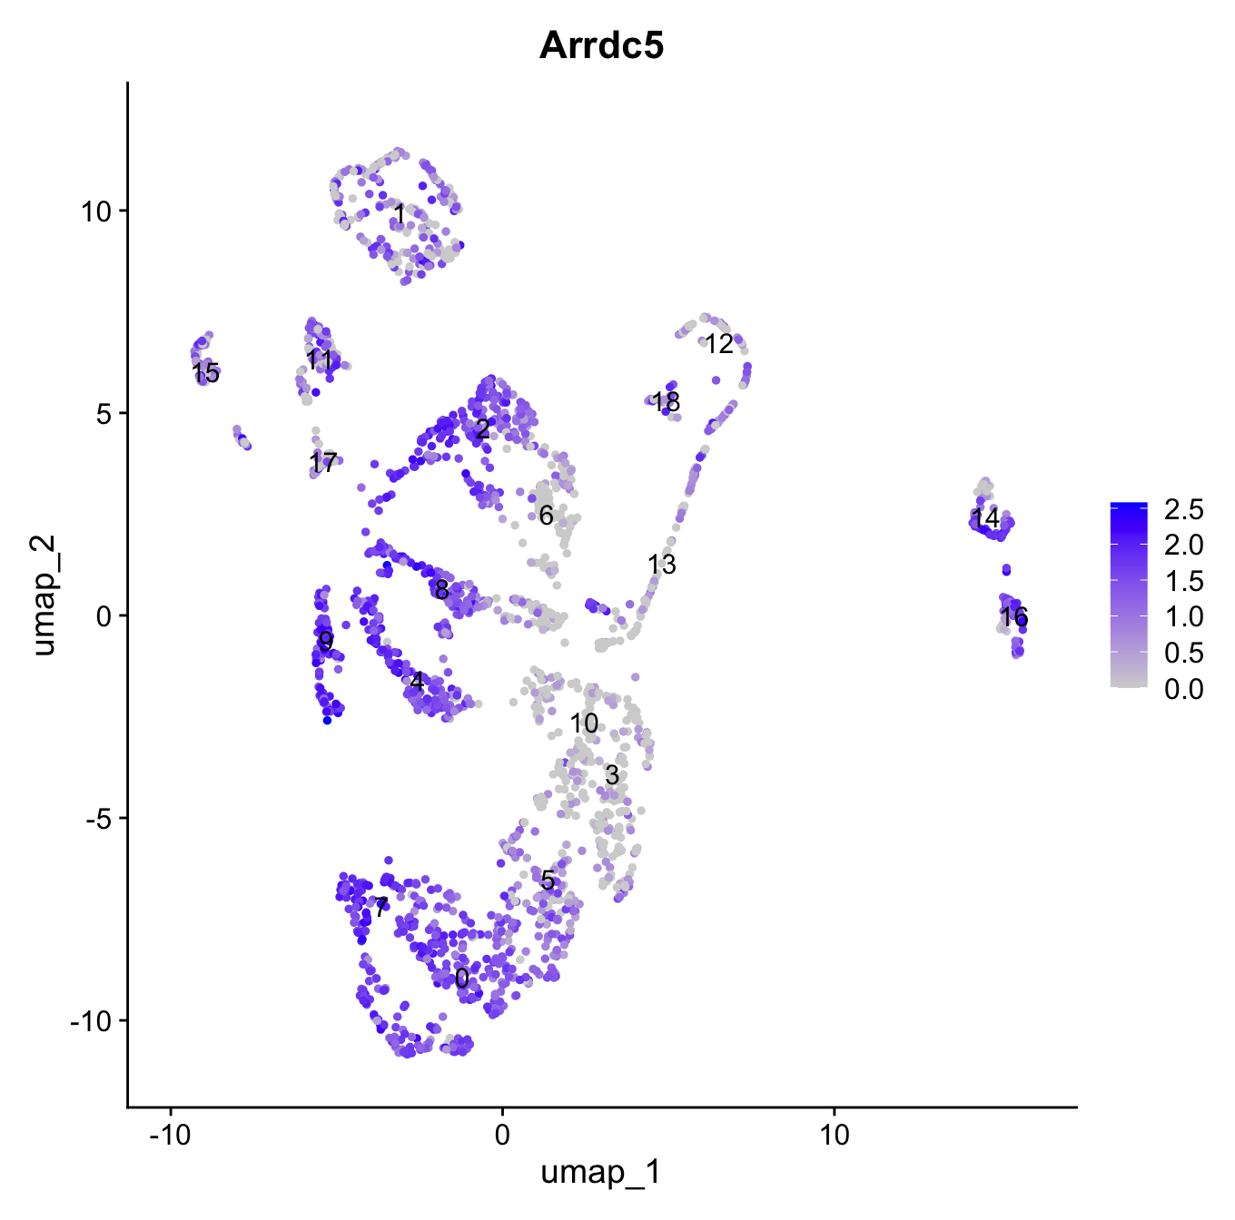
R package of Seurat
Seurat can generate expression profiles itself

Slide 8
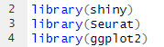
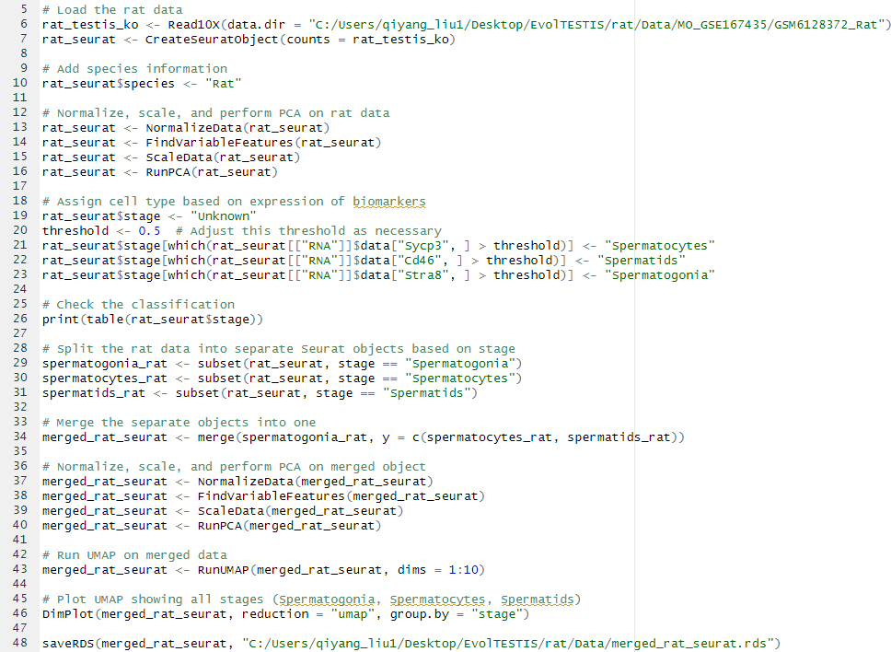
Proceed the data - Seurat
Spermatogonia – Stra8
Spermatocyte – Sycp3
Spermatid – Cd46

Slide 9
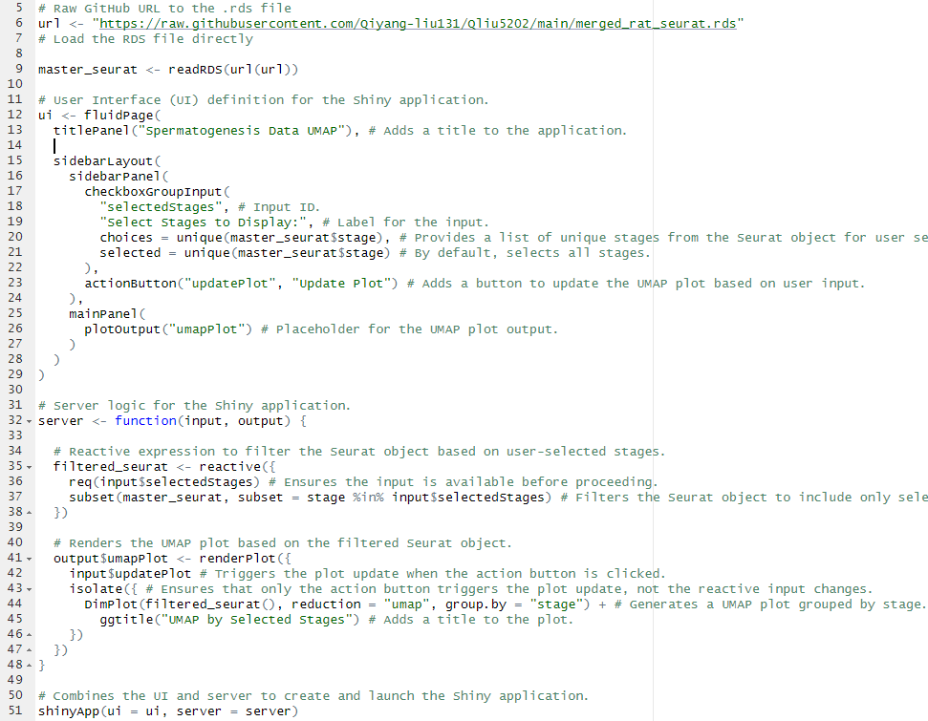
Display the data - Shiny

Slide 10
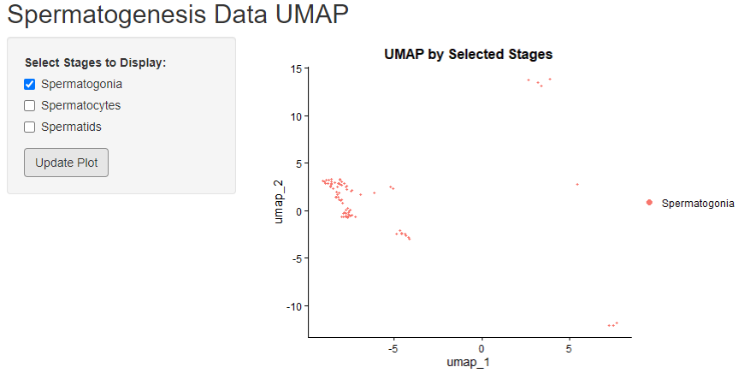
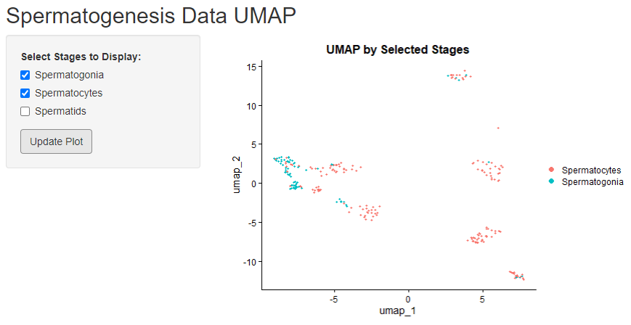
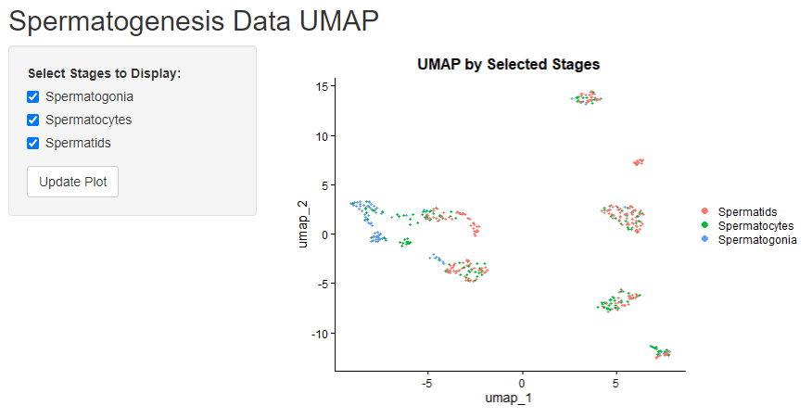
Display the data - Shiny

Slide 11
Future Direction
Access and combine more scRNA-seq datasets
Reduce total file size (continuing work...)
Customize the app with more desired displays
Online server storage for public access

Slide 12
References
Lukassen S, Bosch E, Ekici AB, Winterpacht A. Single-cell RNA sequencing of adult mouse testes. Sci Data. 2018;5:180192. doi:10.1038/sdata.2018.192
Ma HT, Niu CM, Xia J, et al. Stimulated by retinoic acid gene 8 (Stra8) plays important roles in many stages of spermatogenesis. Asian J Androl. 2018;20(5):479-487. doi:10.4103/aja.aja_26_18
Mahyari E, Vigh-Conrad KA, Daube C, et al. The human infertility single-cell testis atlas (HISTA): an interactive molecular scRNA-Seq reference of the human testis. Andrology. Published online 2024. doi:10.1111/andr.13637
Mizuno M, Harris CL, Suzuki N, Matsuo S, Morgan BP. Expression of CD46 in developing rat spermatozoa: ultrastructural localization and utility as a marker of the various stages of the seminiferous tubuli. Biol Reprod. 2005;72(4):908-915. doi:10.1095/biolreprod.104.035485
Ozaki Y, Saito K, Shinya M, Kawasaki T, Sakai N. Evaluation of Sycp3, Plzf and Cyclin B3 expression and suitability as spermatogonia and spermatocyte markers in zebrafish. Gene Expr Patterns. 2011;11(5-6):309-315. doi:10.1016/j.gep.2011.03.002
Posit. Shiny. https://shiny.posit.co/. Accessed March 23, 2025.
R Core Team. 2024. R: A Language and Environment for statistical Computing. From https://www.r-project.org/
Satija Lab. Seurat. https://satijalab.org/seurat/. Accessed March 18, 2025.
Zvick J, Tarnowska-Sengül M, Ghosh A, et al. Exclusive generation of rat spermatozoa in sterile mice utilizing blastocyst complementation with pluripotent stem cells. Stem Cell Reports. 2022;17(9):1942-1958. doi:10.1016/j.stemcr.2022.07.005

